Slide 1
KEYLOGGER PROJECT
PRESENDED BY:
G.THOMAS BELSI
CSE -3rd YEAR
UNIVERSAL COLLEGE OF ENGINEERING AND TECHNOLOGY VALLIOOR

Slide 2
OUTLINE:
WHAT IS KEYLOGGER
TYPES OF KEYLOGGER
HARDWARE KEYLOGGER
SOFTWARE KEYLOGGER
PROBLEM STATEMENT
ADVANDAGE OF KEYLOGGER
DISADVANDAGE OF KEYLOGGER
CONCLUSION

Slide 3
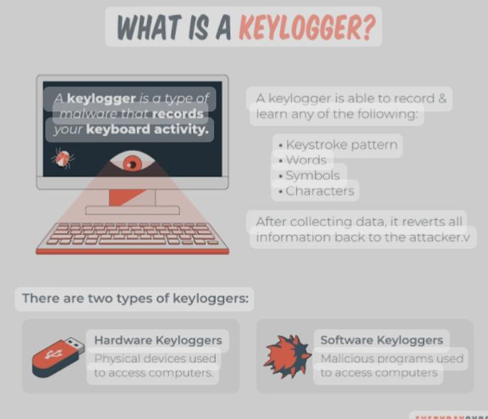
WHAT IS KEYLOGGER:
A computer program that records every keystroke made by a computer user, especially in order to gain fraudulent access to passwords and other confidential information.

Slide 4
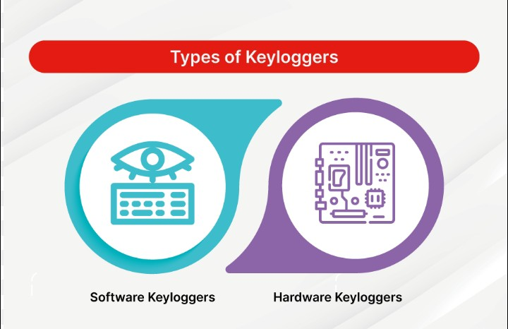
TYPES OF KEYLOGGER:
There are two types of keyloggers: hardware keyloggers and software keyloggers. The two types of keyloggers differ by the way that they log a keystroke.

Slide 5
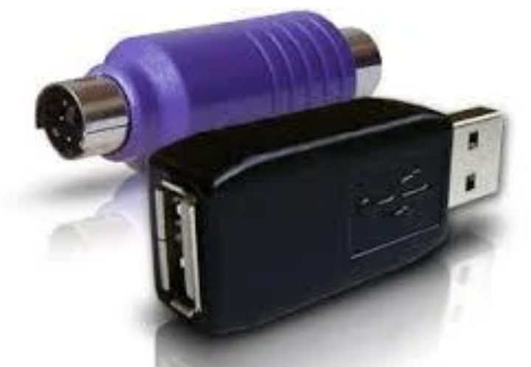
HARDWARE KEYLOGGER:
Hardware keyloggers are used for keystroke logging, a method of capturing and recording computer users' keystrokes, including sensitive passwords.

Slide 6

SOFTWARE KEYLOGGER:
EyeZynis another remote monitoring software suit with great kelogging features along side a full mobile phone data syn capability .
Each keystroke on the target device is capturef even if it ‘s typed into a secured fiel like a passeord field.

Slide 7
PROBLEM STATEMENT
The problem statement is that the keyloggers can be detected using antiviruses. Installation of hardware keyloggers is difficult without the knowledge of the owner of the system.
The solution to the above existing problem is that we can build a software keyloggers instead of hardware keyloggers.

Slide 8

ADVANDAGES OF KEYLOGGER:
*Easy to deploy at scale.
*Inconspicuous user activity monitoring

Slide 9
DISADVANTAGES OF KEYLOGGER:
Often flagged by antimalware software as malicious.
Incapable of logging BIOS inputs.

Slide 10
CONCLUSION:
Keyloggers are a potent threat to both individuals and enterprises, with the potential to cause significant harm if left undetected. Understanding the nature of keyloggers, their methods of infiltration, and the dangers they pose is crucial for maintaining a secure digital environment.

Slide 11
THANK YOU !

